Slide 1
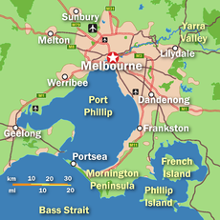
Data Source 1:
Congestion on all roads during 2031 PM peak 2016
(Filter to just Victoria)
GeoJson
Data Vis
HTML/CSS/JavaScript
Data Source 2:
Crowding on suburban trains roads during 2031 PM peak 2016
(Filter to just Victoria)
GeoJson
ETL
Pandas
Clean data
Export to CSV files
Postgres SQL
API Flask/SQL Alchemy
Map displaying congestion/crowding with overlay of weather
Data Source 3:
Weather Data in Australia. Filter for 2016 and only Victoria
CSV

Slide 2
Data Source 1:
Congestion on all roads during 2031 PM peak 2016
(Filter to just Victoria)
GeoJson
Data Vis
HTML/CSS/JavaScript
Data Source 2:
Crowding on suburban trains roads during 2031 PM peak 2016
(Filter to just Victoria)
GeoJson
ETL
Pandas
Clean data
Export to CSV files
Postgres SQL
API Flask/SQL Alchemy
Map displaying congestion/crowding with overlay of weather
Data Source 3:
Weather Data in Australia. Filter for 2016 and only Victoria
CSV

